Slide 1

Education is
  THE
    critical economic driver
Notes:
Education is the critical economic driver…..
Education is a key part of any economic development plan and is key to our economic competitiveness.
We simply have to figure out a way top get more people in Idaho with postsecondary credentials.
It’s the right thing to do!

Slide 2

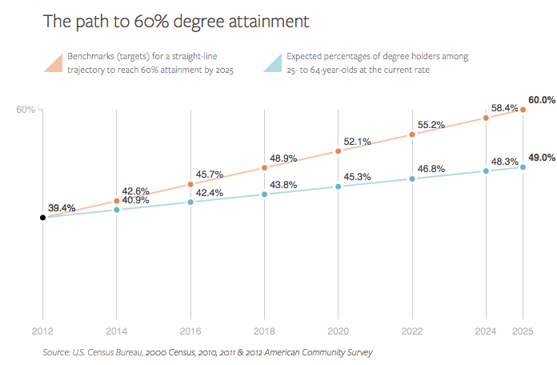
60% of Americans will hold high quality degrees and credentials by 2025 ~ Lumina Foundation
Lumina Foundation, A Stronger Nation through
Higher Education, May 2014

Slide 3
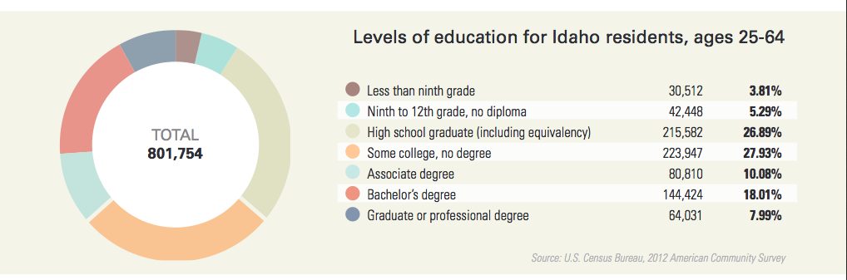
60% of Americans will hold high quality degrees and credentials by 2025 ~ Lumina Foundation
Lumina Foundation, A Stronger Nation through
Higher Education, May 2014

Slide 4
Education and Training Pay
A College Education’s Return on Investment (ROI) in Idaho
Source: Data analyzed from the Idaho Department of Labor and the National Center for Educational Statistics
Notes:
In fact, individual return on investment for higher education is also significant.
The blue bar is the cost of pursuing the education levels noted.
The red bar is the additional earnings an individual can expect to realize in their lifetime.
In fact, the wage differential between those with a degree and those with just a HS credential has never been higher.
Every now and then I hear anecdotal data from people saying business no longer values postsecondary credentials. My answer is simple – look how they invest their hard earned money.

Slide 5
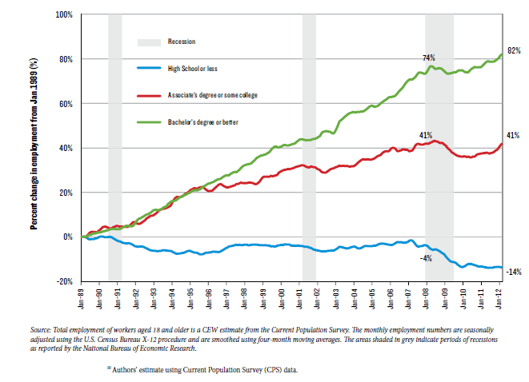
Post Recession 2007:
The Growth has been in college level jobs
Notes:
Another way to look at the relationship between education and the state’s economic future is to look at the type of preparation necessary for jobs in the economy. Bachelor degree jobs have grown by 82%; associate degree jobs by 41% and jobs at the high school preparation level or less have shrunk by another 14%.

Slide 6
Idaho Business for Education (IBE) Study
Data gathered in on-line survey
  466 respondents
  26 organizations
61 percent of jobs by 2018 will require postsecondary credentials
Notes:
So if education is critical to our economic future – both individually and as a state, how are we doing?
Last Fall, the Idaho Business for Education (IBE) conducted an extensive survey of Idaho businesses.
Findings included Idaho data gathered from an on-line survey of 466 respondents from 26 organizations, most of which were at the CEO and executive level. The respondents were geographically located around the state.
The findings suggested that 67% of jobs by 2018 would require some sort of postsecondary education, thus reinforcing other studies the Board used to set the 60% goal.

Slide 8
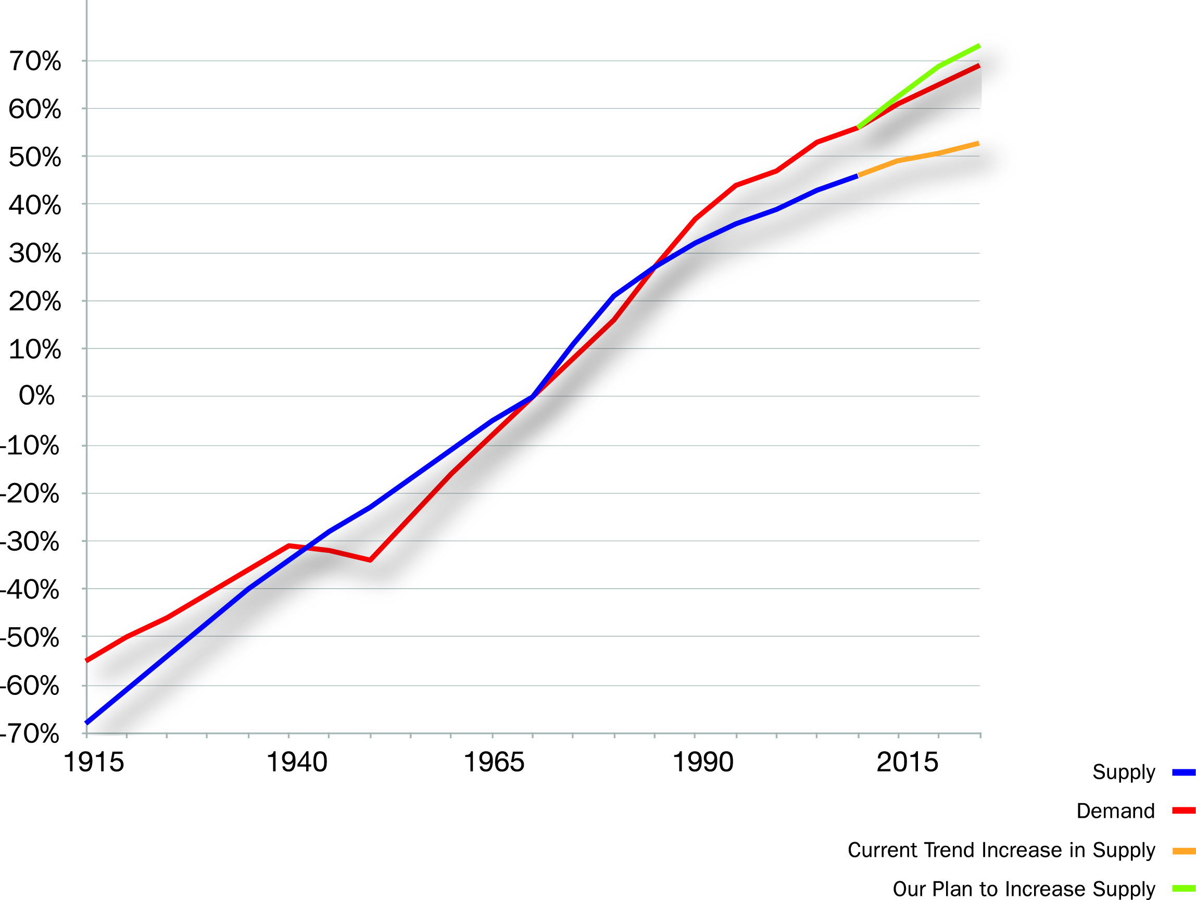
Demand for Certificates and Degrees is Keeping Up
Demand
Almost 20% gap
Supply
Notes:
If We Don’t Increase The Number of People with Certificates and College Degrees, Our Economy Will Underperform. By 2015 we are expecting a gap between demand and supply of college credentials of 20%
We also have a very low go to college rate. Our college success rate is improving, but we still have a long ways to go to become competitive.

Slide 9
60% Goal Progress
Notes:
We are making progress on our 60% goal. We are now between 41 and 42% with a college credential.

Slide 10

60% By 2020
7% Certificates of one year or >
19% associate’s Degrees
34% Bachelor’s Degrees or >
Notes:
I would like to address some confusion about the 60% goal and whether it is needed or realistic. In the first place, this goal specifically targets 25-34 year olds. Secondly that goal breaks down into 34% with a BS degree or greater; 19% with an associate degree and 7% with a certificate of one year or greater. The Board also recognizes the critical need of providing shorter term certificate-level education for the balance of the 40% as well as on-going training for those adults that fall outside of the 25 to 34 year old age range.
(According to Anthony Carnevale, with Georgetown University’s Center on Education and the Workforce, “Nearly two-thirds of these 46.8 million jobs—some 63 percent—will require workers with at least some college education. About 34 percent will require a Bachelor’s degree or better, while 30 percent will require at least some college or a two-year Associate’s degree. Only 36 percent of total jobs will require workers with just a high school diploma or less, and those will be clustered toward the low end of the wage scale.” )

Slide 11
Notes:
One question we get is whether the goal was realistic, especially compared with the performance of other states. This chart just looks at BS degrees or above and shows where Idaho falls within our Western States and a few of the states with higher education levels. 14 states already exceed our 2020 goal of 34%.

Slide 12
In-Migration to Idaho
Notes:
72% of young people now moving into the state have at least some college. This is an improvement from the 66% of young people having at least some college seen only 5 years ago. This speaks to the need for the 60% goal in that Idaho is moving toward a destination for those with postsecondary credentials.
From the Census Bureau’s American Community Survey (2012 data), of 22-39 year olds:

Slide 13
What do we need to do?

Slide 14
Make Higher Education a Key Component of any Economic Development Discussion

Slide 15
Strategies
  Support higher standards
  Improve short-term training
  Improve credit transfer
  Bring adults back into the educational pipeline
  Strengthen PTE both at the secondary and PS level
  Increase college and graduate degrees
  Continue to improve efficiency
Notes:
Strategies
Support higher standards for high school students
Improve demand driven, short-term training that is structured to build into more advanced degrees and credentials
Improve credit transfer
Aggressively bring adults back into the educational pipeline by providing credit for prior learning and experience
State-by-state analysis of employment data show only two other states have seen a greater workforce decline than Idaho among 25- to 54-year-olds. "In 2007, before the recession, 83 percent of people between 25 and 54 in Idaho, were employed," said Jeff Chapman, director of economic health for the Pew Charitable Trusts, a Philadelphia nonprofit that analyzes public policy. "And in the most recent 12 months for which we have data, through June 2014, only 77.3 percent of people in that age group in Idaho were working."
Strengthen PTE both at the secondary and PS level
Increase the number of people getting 4-year college and graduate degrees, especially in high need areas
Continue to drive efficiencies

Slide 16
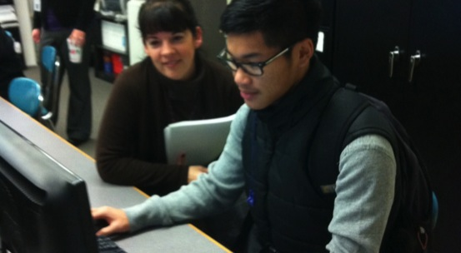
“Sometimes a student going to college is as simple as someone helping them to apply.” (J. Watts, 2010)

Slide 17
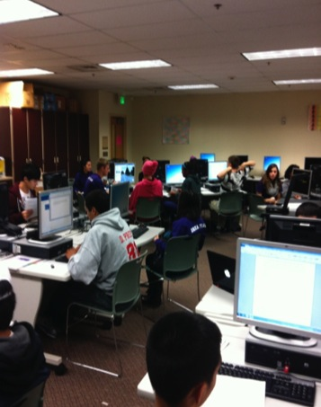
THE BASICS
Focuses on first-generation students
Occurs in the fall (October – November)
Takes place during the school day
Requires collaboration (K-12/HE)
Utilizes existing networks and infrastructure
Promotes College-Going Culture
Uses school personnel and volunteers – low cost

Slide 18
ACAC
Structure: State and Local
Statewide Steering Committee
State Coordinator
ACAC
ACAC Pilot High School
HS Site Coordinator
ACAC Pilot High School
HS Site Coordinator
ACAC Pilot High School
HS Site Coordinator
Students Apply to College!
Notes:
So what does a state do to join the American College Application Campaign?
Step 1. Contact our office and indicate an interest in your state coming on board.
Step 2. Create a statewide steering committee of educational stakeholders such as (public/private pse; community colleges; K-12; college admissions representatives (AACRAO or NACAC; governor’s education liaison; state financial aid guarantor; college access iniatives; etc.)
Step 3. Identify the lead agency (thus far, it is housed in multiple offices – some in K-12; some in higher ed; higher education assistance authority; governor’s office; etc.)
Step 4. Identify a convening date of the statewide steering committee and invite someone from our national office to provide an overview presentation of the effort. (January-July)
Step 5. Identify the pilot schools that you will invite to participate (start small) and determine when your campaign event will occur in the fall. (April – August)
Step 6. Identify the high school site coordinator for the event (school counselor; College Access Network leader; assistant principal; or a teacher) (April-August)
Step 7. Identify a date that the hs site coordinator’s will participate in a training; contact our office to schedule a trainer to visit your site (July-September)
Step 8. Hold event.
Step 9. Evaluate the event.
Step 10. Begin planning for next year’s event.

Slide 19
2005
Alaska
Hawaii
Notes:
North Carolina piloted CAW in a single GEAR UP high school in Chatham County in 2005 after learning that many students participated in the FAFSA event but had not applied to college. The following year, the program was held in 16 high schools, and today, the program is present in every school district in the state.

Slide 20
2008
Alaska
Hawaii
Notes:
At Southern Regional Education Board meetings of the Go Alliance, we talked about our experience with this effort and were soon asked by our SREB neighbors if we would help themget started. Georgia began planning in 2007 and held its first CAC event in 2008. During that same fall, Tennessee piloted the effort in 14 rural high schools.

Slide 21
2010
Alaska
Hawaii
Notes:
And in 2010, Colorado and Florida piloted efforts.
At this time, there was a joint meeting of SHEEOs and CSSOs – The question was asked “what can we do to engage Higher Education with K-12” – Bobby Kanoy was at that meeting and shared the practice he had championed in North Carolina and that was gathering some traction in other states.
He put together a National Steering Committee and started telling the story to funders.
Lumina Foundation
The Kresge Foundation
Bill & Melinda Gates Foundation
Bank of America Charitable Foundation

Slide 22
2012
DC
Alaska
Hawaii
Notes:
By Fall 2011, three additional states became College Application Campaign states – Minnesota, Michigan, and Kentucky.
And in 2012 – 14 states and the District of Columbia piloted the campaign. Arizona, Delaware, DC, Hawaii, Illinois, Iowa, Massachusetts, Montana, Ohio, Oklahoma, Oregon, Rhode Island, Virginia, Washington, Wisconsin

Slide 23
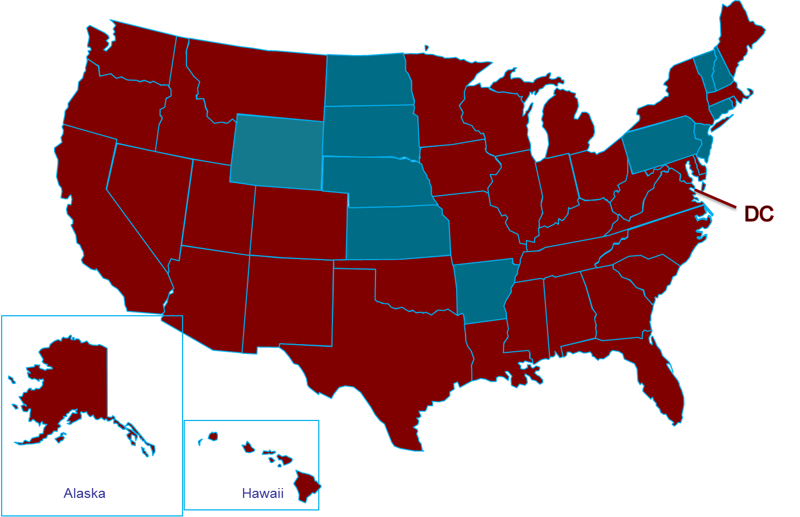
2013
Notes:
Idaho participated for the first time, last year, in 2013. As you can see all but 11 states participated in 2013.

Slide 24
2014
DC
Alaska
Hawaii

Slide 25
Results

Slide 26
ACAC Impact
Data Variables Collected
Number of participating high schools
Number of participating students
Number of applications submitted
2013 National ACAC Program Results
39 states and the District of Columbia implemented programs
2,513 high schools
153,114 students participated
219,855 college applications were submitted
National Student Clearinghouse
North Carolina has determined annually that 68% to 79% of students who apply during their College Application Week program enroll in college the following fall semester

Slide 27
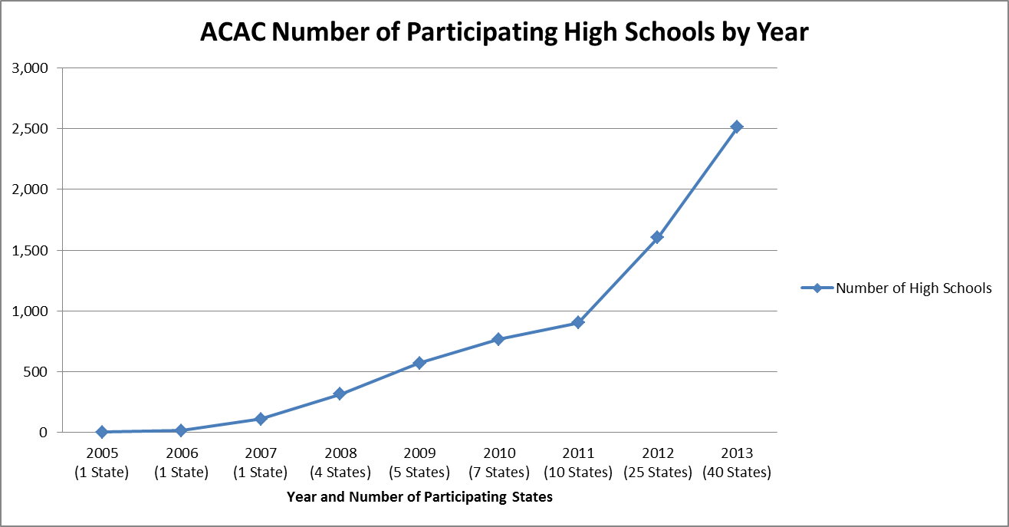
ACAC Impact

Slide 28
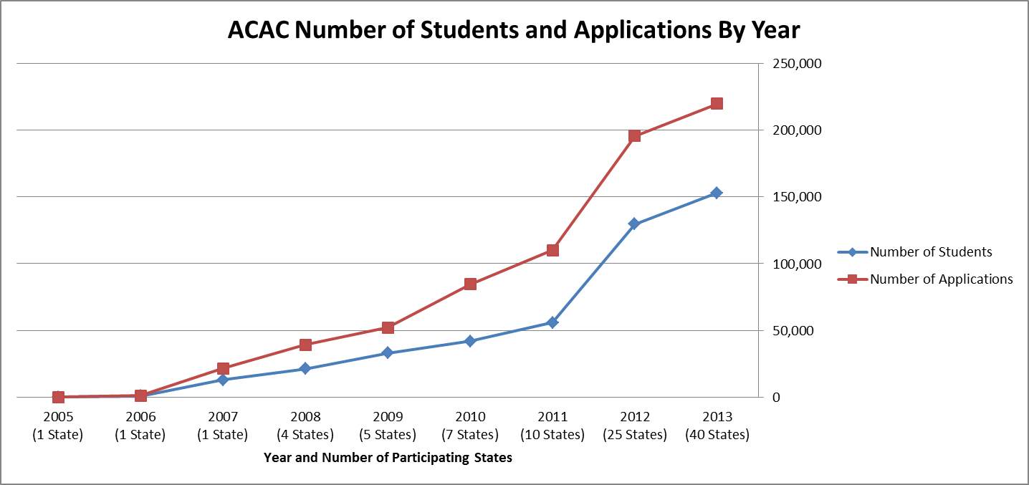
ACAC Impact

Slide 29


PARTICIPANTS
21
SITES ACROSS
IDAHO
SNAPSHOT 2013
SCHOOLS OF ALL SIZES WERE
CHOSEN FROM ALL REGIONS
OF THE STATE
Notes:
21 high schools from around Idaho participated in the pilot program.
Schools of different sizes and from different regions were selected to participate.

Slide 30

PARTICIPANTS
2,369
SNAPSHOT 2013
SENIORS
PARTICIPATED
78%
74%
OF STUDENTS PLAN TO
ATTEND OTHER COLLEGE
REDINESS ACTIVITIES
OF SENIORS SUBMITTED AT
LEAST ONE APPLICATION
Notes:
3,196 seniors attended the 21 pilot high schools.
2,369 seniors submitted at least one college application during the campaign.
74% of seniors applied to at least one college during the campaign.

Slide 31

STUDENTS REPORT TALKING WITH THEIR PARENTS ABOUT COLLEGE
82%
SNAPSHOT 2013
OF STUDENTS
HAVE DISCUSSED APPLYING
FOR COLLEGE
57%
OF STUDENTS
HAVE DISCUSSED APPLYING
FOR FINANCIAL AID

Slide 32

COLLEGE APPLICATIONS AS REPORTED BY STUDENT SURVEYS
3,672
SNAPSHOT 2013
APPLICATIONS
WERE SUBMITTED DURING THE
CAMPAIGN
Notes:
3,672 applications were submitted during the campaign.
74% of seniors applied to at least one college during the campaign.

Slide 33
COLLEGE APPLICATIONS AS REPORTED BY STUDENT SURVEYS
APPLICATIONS WENT TO:
ALL
IDAHO PUBLIC
COLLEGES AND
UNIVERSITIES
SNAPSHOT 2013
OUT OF STATE
IN IDAHO
16%
84%
Notes:
Applications were submitted to all Idaho Public Colleges and Universities.
84% of all applications submitted were to accredited Idaho Colleges and Universities.
16% of all applications submitted were to out of state institutions.

Slide 34
COLLEGE APPLICATIONS AS REPORTED BY STUDENT SURVEYS
APPLICATIONS WENT TO:
136
POSTSECONDARY
INSTITUTIONS
SNAPSHOT 2013
Notes:
To Idaho Public Colleges and Universities (1,956) 75%
To Idaho Private or Proprietary Institutions (222) 9%
To Out of State Public Colleges and Universities (298) 11%
To Out of State Private or Proprietary Institutions (117) 5%

Slide 35
STUDENTS ARE DISCUSSING THEIR PLANS WITH PARENTS
82% have discussed applying for college.
57% have discussed applying for financial aid.
54% discussed College Application Week.
2013 DATA
Notes:
78% of students plan to attend other college readiness activities, like financial aid nights, campus visits, etc.

Slide 36
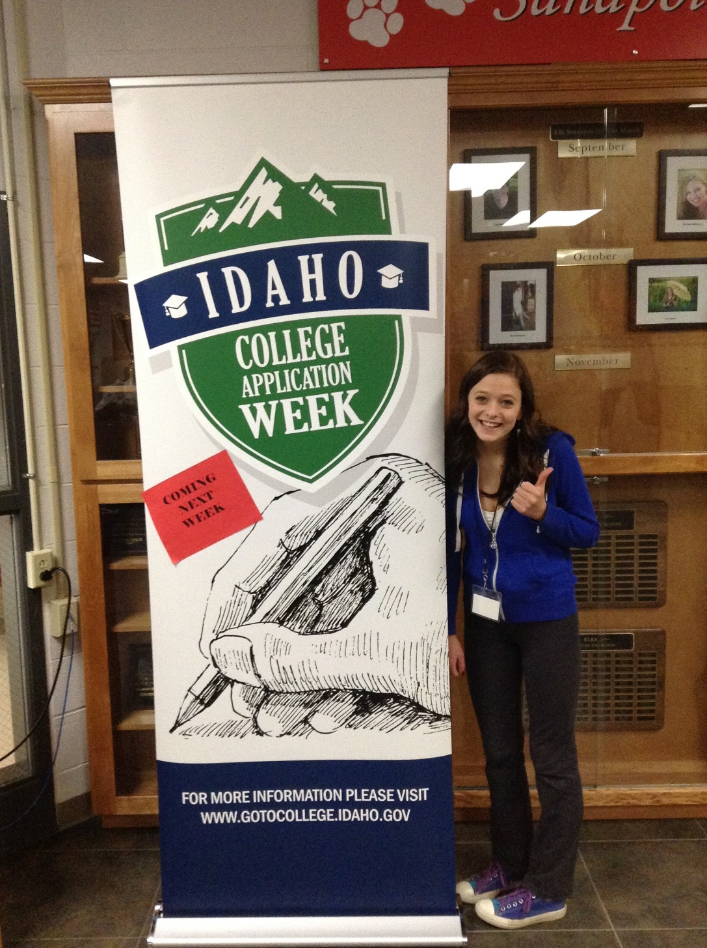
Banner
Notes:
Sandpoint High School

Slide 37
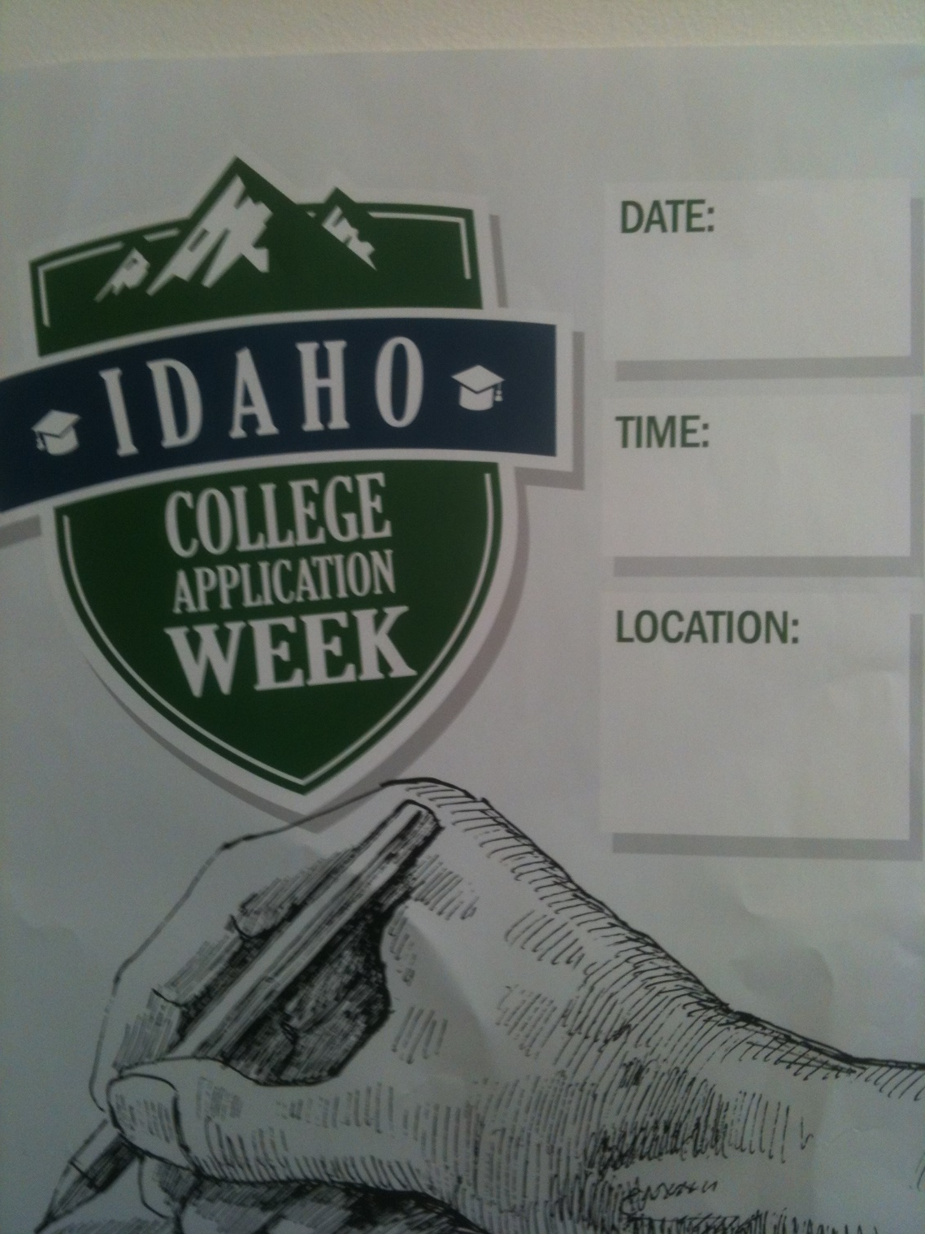
Enter Text Here
Poster
Notes:
Each school should have two posters. These can be customized for your times and locations, yet still tie to the theme for Idaho College Application Week. If you need more posters, we have provided on the website resources an 11X 17 PDF that you can print off at your school.
In addition to the banner and posters, we have provided you with “I applied Stickers and Don’t forget the FAFSA Stickers

Slide 38

Text here
Notes:
Juan from the University of Idaho and Tazha from the College of Western Idaho are representing IACRAO, the Idaho Association of Collegiate Registrars and Admissions Officers
In order for IACRAO to provide you some expertise during your event, it is critical that you complete the pre-event survey. This way they can work to coordinate volunteers to be at your site.
IACRAO volunteers will be prepared to assist your students with application regardless of where the student is applying or which institutions the IACRAO volunteer works.
For a success full

Slide 39
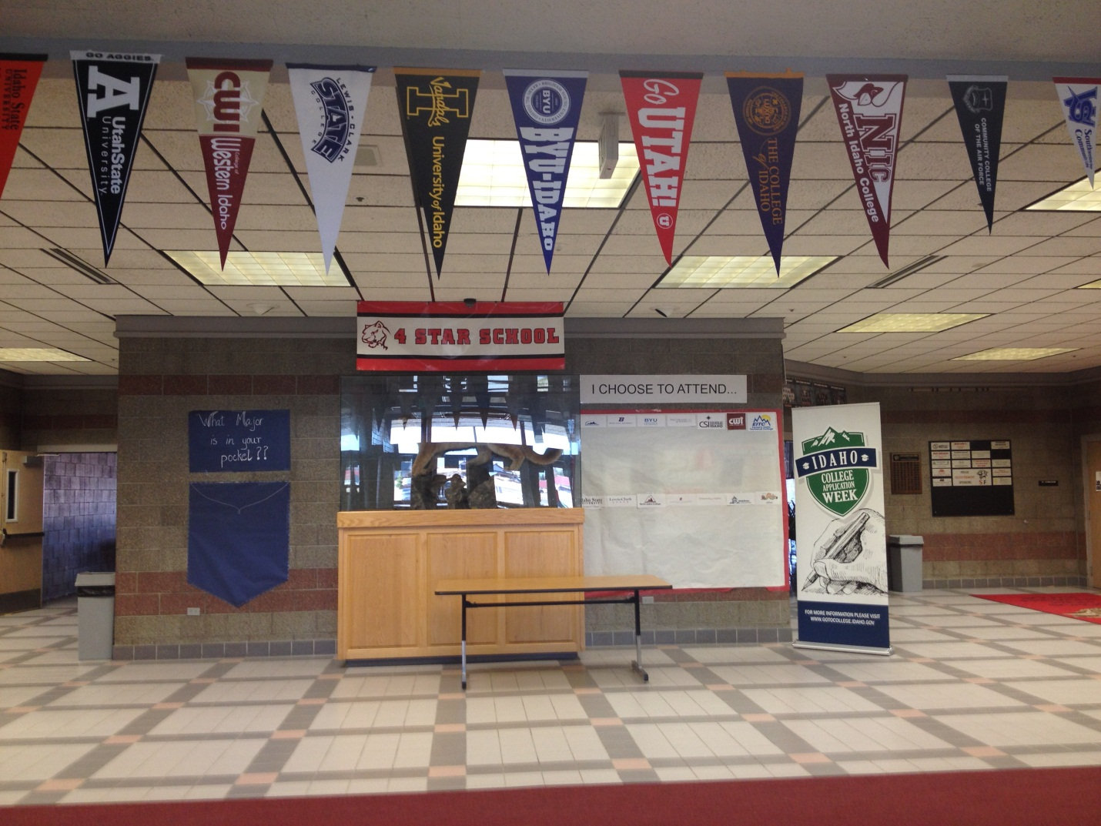
Create excitement!
Enter Text Here
Notes:
South Freemont High School

